Slide 1
Unit V Applets
Subject Incharge
A.P.Ghatol

Slide 2
Applets
Java programs are divided into two main categories, applets and applications
An application is an ordinary Java program
An applet is a kind of Java program that can be run across the Internet
Applets are stand-alone applications that occasionally get compiled and linked into machine code, frequently compiled into byte codes.
Contains any number of components, such as buttons, text fields, pictures, etc.
Can respond to user-initiated events, such as mouse clicks or keyboard presses

Slide 3
Applets…
APPLICATION
APPLET
An application is a standalone Java program which can be run independently on client/server without the need of a web browser.
An application is the programs executed on the computer independently.
Uses the main method for execution
Can run alone but require JRE.
It doesn’t require any Graphical User Interface (GUI).
An applet is a form of Java program which is embedded with an HTML page and loaded by a web server to be run on a web browser.
It is small program uses another application program for its execution.
Do not use the main method.
Cannot run independently require API's (Ex. Web API).
It must run within a GUI.

Slide 4
Defining Applets
An applet is a small internet-based program written in Java.
The applet is usually embedded in an HTML page on a web site and can be executed from within a browser.
An applet is a Java class that extends the java.applet.Applet class.
A main method is not invoked on an applet, and an applet class will not define main.
Advantage of Applet
There are many advantages of applet. They are as follows:
It works at client side so less response time.
Secured
It can be executed by browsers running under many plateforms, including Linux, Windows, Mac Os etc.
Drawback of Applet
Plugin is required at client browser to execute applet.

Slide 5
Class Hierarchy for Applets
The AWT allows us to use various graphical components.
To write any applet program it essentially has to import two packages namely – java.awt and java.applet.
The java.applet package contains a class Applet
The applet class is an extension of Panel class belonging to java.awt package.
To create an user friendly graphical interface we need to place various components on GUI window.
There is a Component class from java.awt package which derives several classes for components. These classes include Check box, Choice, List, buttons and so on.
The Component class in java.awt is an abstract class.

Slide 6
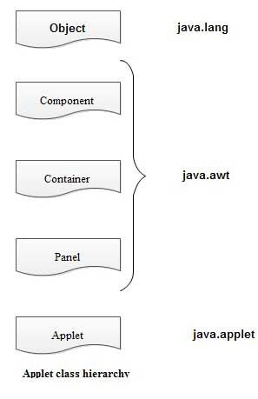
Class Hierarchy for Applets…
java.lang.Object
|
+----java.awt.Component
|
+----java.awt.Container
|
+----java.awt.Panel
|
+----java.applet.Applet

Slide 7
Applets
The Applet CLASS:
Every applet is an extension of the java.applet.Applet class.
The base Applet class provides methods that a derived Applet class may call to obtain information and services from the browser context.
These include methods that do the following:
Fetch an image
Fetch an audio clip
Play an audio clip
Resize the applet
Get applet parameters
Get the network location of the HTML file that contains the applet
Get the network location of the applet class directory Print a status message in the browser

Slide 8
Running an Applet
An applet class is compiled in the same way as any other Java class.
The normal way to run an applet is to embed it in an HTML document.
The applet is then run and viewed through a Web browser.
An applet can also be viewed using an applet viewer.
The Java applet viewer can be used to run an applet:
appletviewer FirstApplet.html

Slide 9
Applets
import java.awt.*;
import java.applet.*;
public class HelloWorld extends Applet
{ public void paint( Graphics g )
{
g.drawString( "Hello World!", 30, 30 );
}
}
Save this file with Helloworld.java

Slide 10
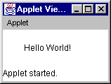
Running an Applet…
<html>
<head>
<title> Hi World Applet </title>
</head>
<body>
<applet code="HelloWorld.class” width=300 height=200>
</applet>
</body>
</html>
Save this file with an extension .html

Slide 11
Running an Applet…
Another way to run an applet is , to give the below HTML coding as a comment in the HelloWorld.java, as below
/*<applet code="HelloWorld.class” width=300 height=200></applet>*/
import java.awt.*;
import java.applet.Applet;
public class HelloWorld extends Applet
{ public void paint( Graphics g )
{
g.drawString( "Hello World!", 30, 30 );
}
}
then execute the applet as , appletviewer HelloWorld.java

Slide 12
Applet Life Cycle
There is No Main Method, applets starts its execution by its methods
When an applet is loaded, it undergoes a series of changes in its state.
The applet states include:
Born or initialization state
Running state
Idle state
Dead or destroyed state

Slide 13
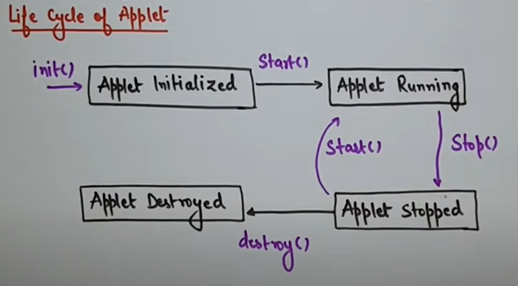
Applet Life Cycle….
The changes in state of applet life is shown in the following state transition diagram

Slide 14
Applet Life Cycle….
Initialization / Born state:
Applet enter this state when it is first loaded
This is achieved by calling init() method
The init( ) method is the first method to be called.
Initialize variables in this method and create the objects
This method is called only once during the life time of your applet
Running state:
Applet enters into running state when it calls start() method
The start( ) method is called after init( )
It is also called to restart an applet after it has been stopped
start() method may be called any number of times
When a user leaves a web page and comes back, the applet resumes execution

Slide 15
Applet Life Cycle….
Idle or stopped state:
Applet becomes idle when it is stopped
Stopping automatically occurs when we leave the page containing the
current applet
We can achieve this by calling stop() method
stop() method suspends applet execution until the user clicks on it
Dead state:
Applet is said to be dead when it is removed from memory.
This occurs by calling destroy() method
The destroy() method perform shutdown activities
It also removes the applet from the memory
Display state
Applet moves to the display state whenever it has to perform some
output operation on the screen
The paint() method is called to accomplish this task
Paint() method does absolutely nothing
We have to override this method to display the required graphics

Slide 16
Methods are called in this order
init and destroy are only called once each
start and stop are called whenever the browser enters and leaves the page
do some work is code called by your listeners
paint is called when the applet needs to be repainted
init()
start()
do some work
stop()
destroy()

Slide 17
Applet Class Methods
public void init ()
public void start ()
public void stop ()
public void destroy ()
public void paint (Graphics g)
Also:
drawString():This method is a member of Graphics class, used to output a string to an applet. it is typically called from within the paint() or update() method. Its form is:
void drawstring(String string.msg,int a, int b)
setBackground(): This method belongs to Component class. It is used to set the background color of the applet window. Its form is:
void setBackground(Color.anyColor)
setForeground():This method is used to set the color of the text to be displayed on the foreground of the applet window. Its form is:
void setForeground(Color anyColor)

Slide 18
showStatus():
This methd is a member of Applet class. It is used to display any string in the status window of the browser or appletviewer. Its from is
void showStatus(String text)
Here, the argument of the method is basically the string which you want to be displayed in the status window.

Slide 19
Applet Class Methods…
The class Component defines methods called paint(), repaint() and update().
paint(): paint() is where you place code for drawing, writing etc. paint() is given a Graphics context as a parameter.
update(): update is called when the window is re-sized. The default implementation of update(): first clears the background; then calls paint()
repaint(): The repaint() is intended to allow various methods to call for a re-rendering of the component. No graphics context is needed for repaint(). A call to repaint() calls update().

Slide 20
Commonly used methods of Graphics class:
public abstract void drawString(String str, int x, int y): is used to draw the specified string.
public void drawRect(int x, int y, int width, int height): draws a rectangle with the specified width and height.
public abstract void fillRect(int x, int y, int width, int height): is used to fill rectangle with the default color and specified width and height.
public abstract void drawOval(int x, int y, int width, int height): is used to draw oval with the specified width and height.
public abstract void fillOval(int x, int y, int width, int height): is used to fill oval with the default color and specified width and height.
public abstract void drawLine(int x1, int y1, int x2, int y2): is used to draw line between the points(x1, y1) and (x2, y2).
public abstract boolean drawImage(Image img, int x, int y, ImageObserver observer): is used draw the specified image.
public abstract void drawArc(int x, int y, int width, int height, int startAngle, int arcAngle): is used draw a circular or elliptical arc.
public abstract void fillArc(int x, int y, int width, int height, int startAngle, int arcAngle): is used to fill a circular or elliptical arc.
public abstract void setColor(Color c): is used to set the graphics current color to the specified color.
public abstract void setFont(Font font): is used to set the graphics current font to the specified font.

Slide 21
Sample Graphics methods
A Graphics is something you can paint on
g.drawString(“Hello”, 20, 20);
Hello
g.drawRect(x, y, width, height);
g.fillRect(x, y, width, height);
g.drawOval(x, y, width, height);
g.fillOval(x, y, width, height);
g.setColor(Color.red);

Slide 22
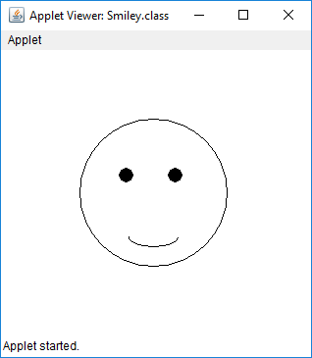
// Java program to Draw a
// Smiley using Java Applet
import java.applet.*;
import java.awt.*;
public class Smiley extends Applet {
public void paint(Graphics g)
{
// Oval for face outline
g.drawOval(80, 70, 150, 150);
// Ovals for eyes
// with black color filled
g.setColor(Color.BLACK);
g.fillOval(120, 120, 15, 15);
g.fillOval(170, 120, 15, 15);
// Arc for the smile
g.drawArc(130, 180, 50, 20, 180, 180);
}
} //<applet code= Smiley.class height=300 width=300></applet>

Slide 23
MORE ABOUT APPLET TAG
We have used the applet tag while writing code for applets. An applet has to be specified in an HTML file. This can done by using APPLET tag in an HTML file,
Apples are executed by a Java enabled web browser as soon as it encounters the APPLET tag inside the HTML file
If you want to view and test an applet using the utility, appletviewer,of JDK, you just have to include a comment containing the APPLET tag, just above the actual applet code.
we have been using the following form of APPLET tag,
<APPLET CODE = filename WIDTH =pixels HEIGHT= pixels>
</APPLET>
This is the most simplified form of APPLET tag, having only the mandatory fields as attributes.

Slide 24
The full syntax of the APPLET tag is shown below
Let us discuss about the use of these attributes in detail,
CODEBASE: Here, we may specify the URL of the directory where the executable class file (specified by CODE attribute) of the applet will be searched for.
CODE: It gives the name of the file containing the applet's compiled class file. It is a mandatory attribute, which should always be present in APPLET tag.
ALT: It is an attribute, which is used to specify the alternate short text message that should be displayed in case the browser recognizes the HTML tag but cannot actually run the applet because of some reason.
NAME: It is possible to give a name to an applet's instance using this optional attribute.If any other applet on the same web page wants to communicate with this applet, it is referenced through its NAME only.
WIDTH: It gives the width of the applet display area in terms of pixels.
HEIGHT: It gives the height of the applet display area in terms of pixels.

Slide 25
<APPLET [CODEBASE= codebasedURL] CODE- appletFile (ALT= alternateText] [NAME=appletInstanceName] WIDTH=pixels HEIGHT=pixels[ALIGN= alignment] [VSPACE =pixels][HSPACE - pixels]>
[<PARAM NAME = attributellame VALUE = attributevalue]
[<PARAM NAME = attributellare VALUE = attributevalue]
</APPLET>

Slide 26
ALIGN: This optional attribute is used to set the alignment of an applet. The alignment can be set as LEFT, RIGHT, TOP, BOTTOM, MIDDLE, BASELINE, TEXTTOP, ABSMIDDLE, and ABSBOTTOM.
VSPACE: These are used to specify the space, in pixels, above and below the applet.
HSPACE: These are used to specify the space, in pixels, on each side of the applet.
You can use PARAM tags between the <APPLET> and </APPLET> tags to provide
information about parameters, or arguments, to be used by the Java applet. The <PARAM> tag is simple—it NAMES a parameter the JAVA applet needs to run, and provides a VALUE for that parameter.
User-defined parameters can be supplied to an applet using <PARAM.......> tags.
This tag has two parameters: NAME and VALUE.
NAME: attribute name
VALUE: value of the attribute named by corresponding PARAM NAME.
The applets access their attributes using the getParameter() method. It signature is as follows:
String getParameter(String name);

Slide 27
Parameter in Applet
We can get any information from the HTML file as a parameter. For this purpose, Applet class provides a method named getParameter(). Syntax:
public String getParameter(String parameterName)
Example of using parameter in Applet:
import java.applet.Applet;
import java.awt.Graphics;
public class UseParam extends Applet{
public void paint(Graphics g){
String str=getParameter("msg");
g.drawString(str,50, 50);
}
}

Slide 28
<html>
<body>
<applet code="UseParam.class" width="300" height="300>
<param name="msg" value="Welcome to applet">
</applet>
</body>
</html>

Slide 29
getDocumentBase () AND getCodeBase () Methods
getDocumentBase(): It is the URL of the directory containing the HTML document that loads the Applet.
Gets the URL of the directory in which this applet is embedde inside<html> </html> tag.
getCodeBase():gets the URL of the file containing applets classfile.

Slide 30
/ Display code and document bases.
import java.awt.*;
import java.applet.*;
/*<applet code="Bases" width=300 height=50> </applet>*/
public class Bases extends Applet {
// Display code and document bases.
public void paint(Graphics g) {
String msg;
url = getCodeBase(); // get code base
msg1 = "Code base: " + url.toString();
g.drawString(msg1, 10, 20);
url = getDocumentBase(); // get document base
msg2 = "Document base: " + url.toString();
g.drawString(msg2, 10, 40);
}
}

Slide 31
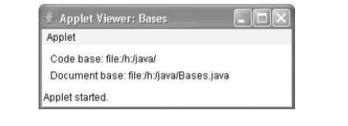

Slide 32
Color class
The Color class is a part of Java Abstract Window Toolkit(AWT) package. The Color class creates color by using the given RGBA values where RGBA stands for RED, GREEN, BLUE, ALPHA or using HSB value where HSB stands for HUE, SATURATION, BRIcomponents. The value for individual components RGBA ranges from 0 to 255 or 0.0 to 0.1. The value of alpha determines the opacity of the color, where 0 or 0.0 stands fully transparent and 255 or 1.0 stands opaque.

Slide 33
Constructors of Color Class
Color(ColorSpace c, float[] co, float a) : Creates a color in the specified ColorSpace with the color components specified in the float array and the specified alpha.
Color(float r, float g, float b) : creates a opaque color with specified RGB components(values are in range 0.0 – 0.1)
Color(float r, float g, float b, float a) : creates a color with specified RGBA components(values are in range 0.0 – 0.1)
Color(int rgb): Creates an opaque RGB color with the specified combined RGB value consisting of the red component in bits 16-23, the green component in bits 8 – 15, and the blue component in bits 0-7.
Color(int rgba, boolean b): Creates an sRGB color with the specified combined RGBA value consisting of the alpha component in bits 24-31, the red component in bits 16 – 23, the green component in bits 8 – 15, and the blue component in bits 0 – 7.
Color(int r, int g, int b) : Creates a opaque color with specified RGB components(values are in range 0 – 255)

Slide 34
Some of the methods of Color Class
getColorSpace()returns the ColorSpace of this Color.
getGreen()returns the green component in the range 0-255 in the default sRGB space.
getRed()returns the red component in the range 0-255 in the default sRGB space.
getRGB()Returns the RGB value representing the color in the default sRGB ColorModel.
getHSBColor(float h, float s, float b)Creates a Color object based on the specified values for the HSB color model.
getTransparency()returns the transparency mode for this Color.

